Slide 1
Project Spacewalk
Presented by:
Tanushree Sharma
1484389
05/13/2019
Presented to:
Dr. Michael James Findler

Slide 2
Contents
Introduction
Current Features
Scripted task – level 01
Scripted task – level 02
Diagrams
Screenshots
What did I learn?
Conclusion
Project Demo

Slide 3
Introduction
Developed in Unity using C#
Login:
Username and password
Main Menu consist of :
Play
Settings
About
Exit

Slide 4
Current Features
Game has two levels:
Level 01
Level 02

Slide 5
Scripted task – Level 01
User task is about 45 seconds
Click “V” to turn on visor
Click on the blue dot to open capsule
Use of “w” to move forward, “s” to move backward.
Use of “c” to open and close camera
Use left mouse button for clicking pictures.

Slide 6
Scripted task – Level 02
User task is for 90 seconds long.
Follow the blue dot tagged on planets
Use of “w” to move forward, “s” to move backward, “a” to move left side and “d” to move right side.
Use left mouse button for clicking pictures

Slide 7
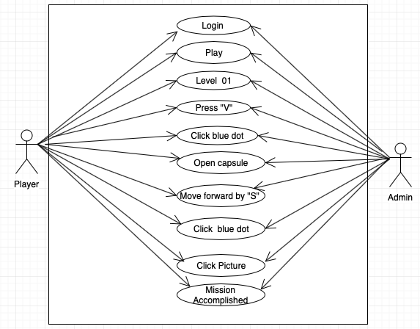
Use case Diagram
Level 01

Slide 8
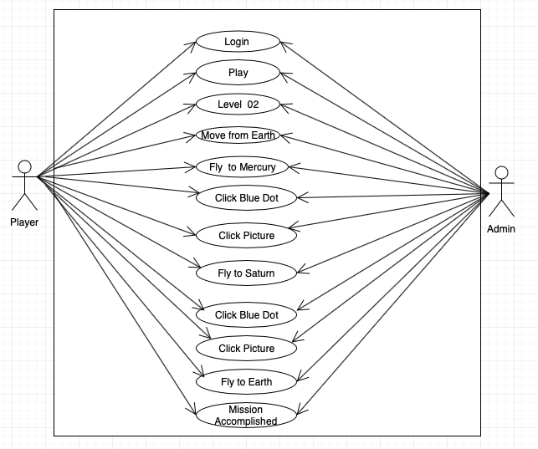
Use case Diagram
Level 02

Slide 9
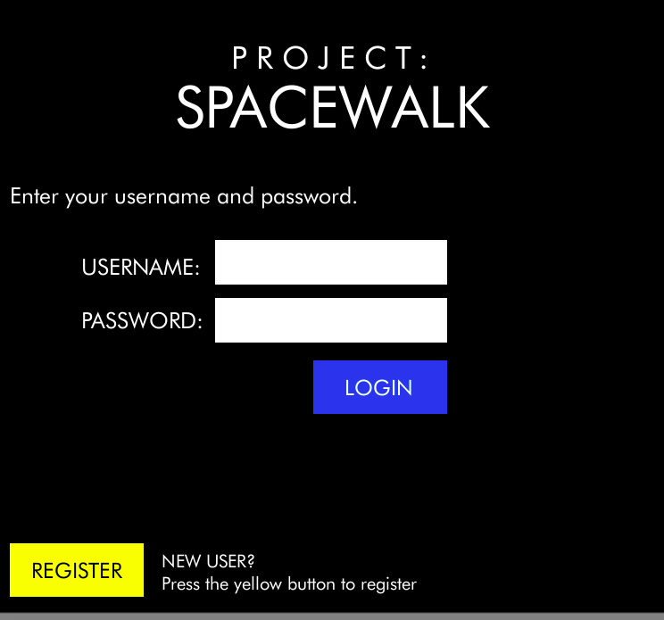
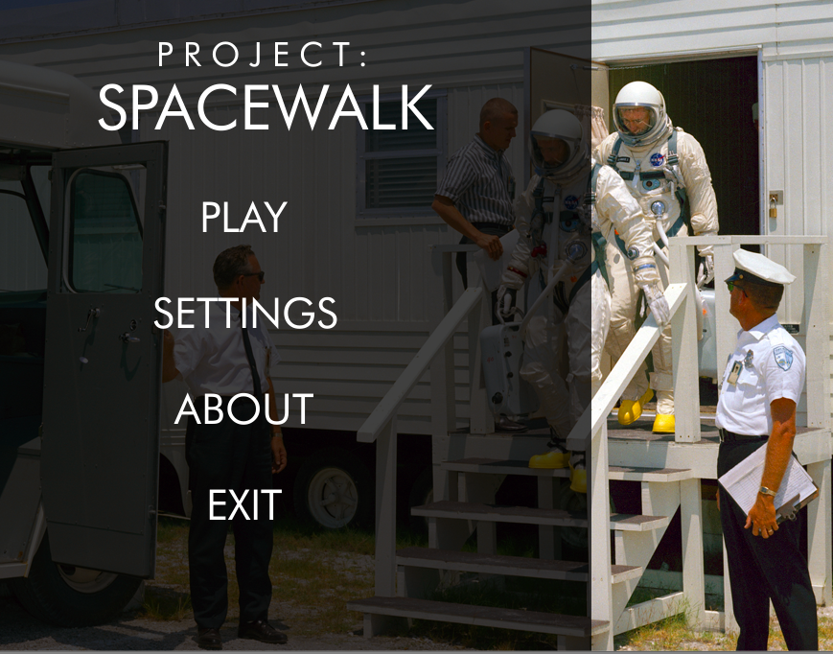
Screenshots
LOGIN
MAIN MENU

Slide 10
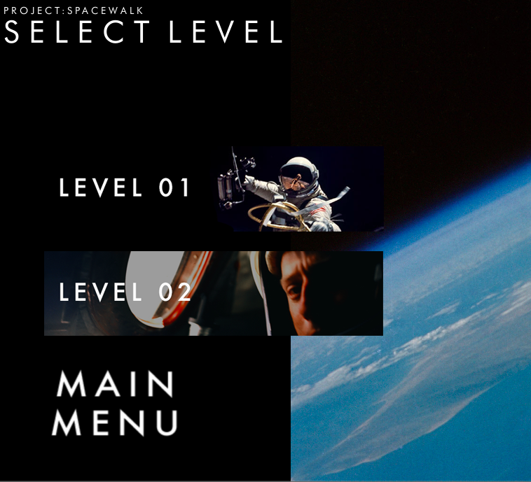
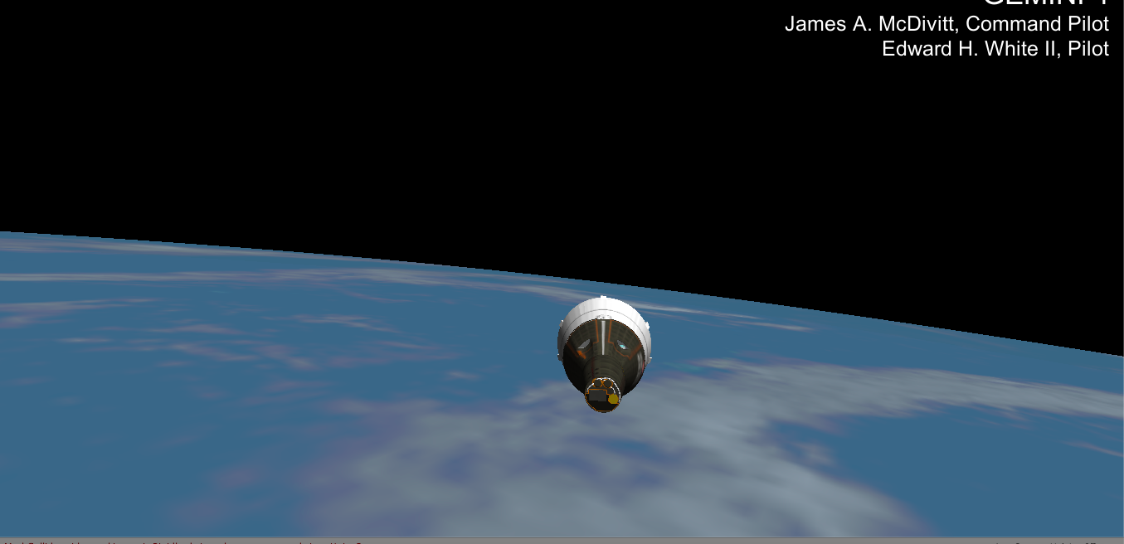
Screenshots
LEVELS
LEVEL - 01

Slide 11
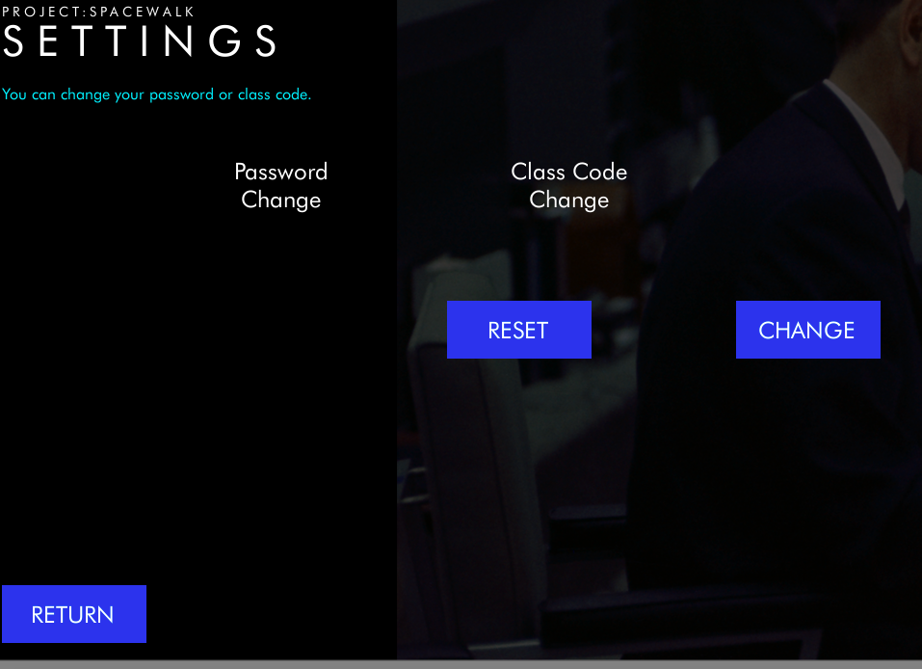
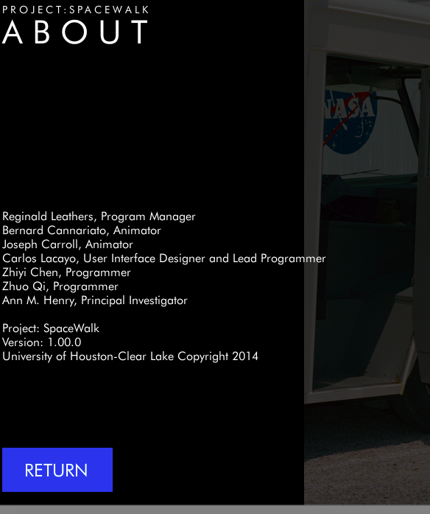
Screenshots
SETTINGS
ABOUT

Slide 12
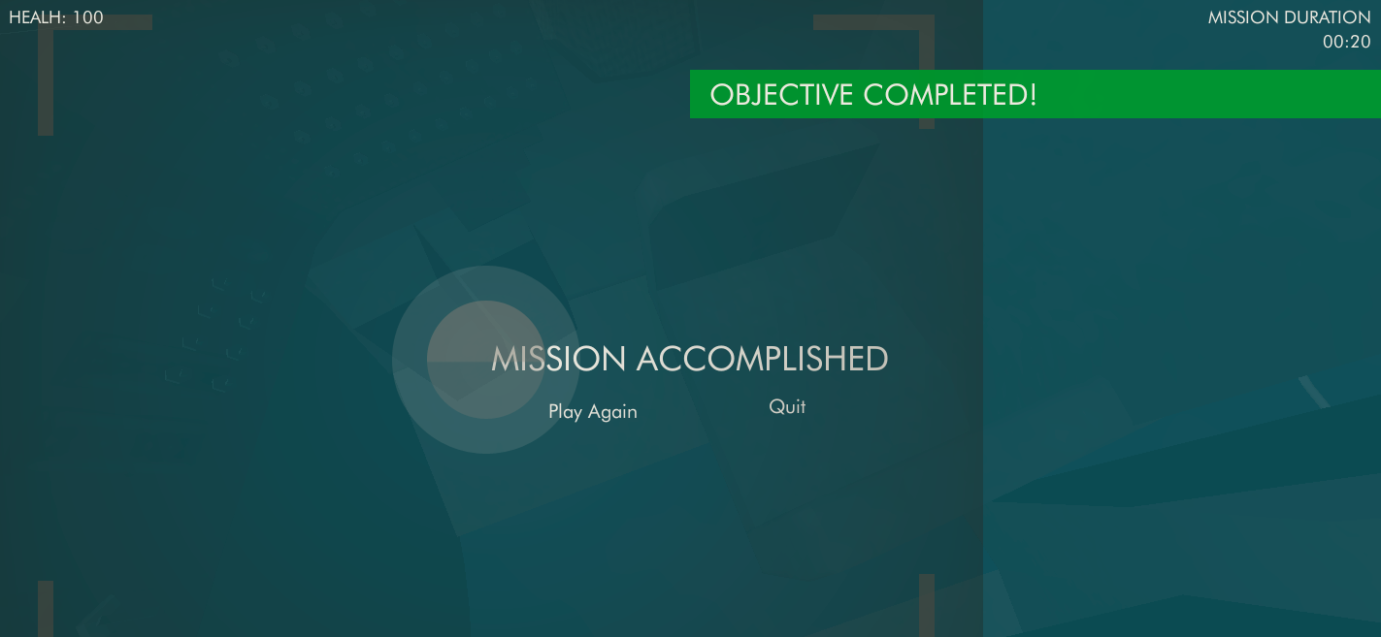
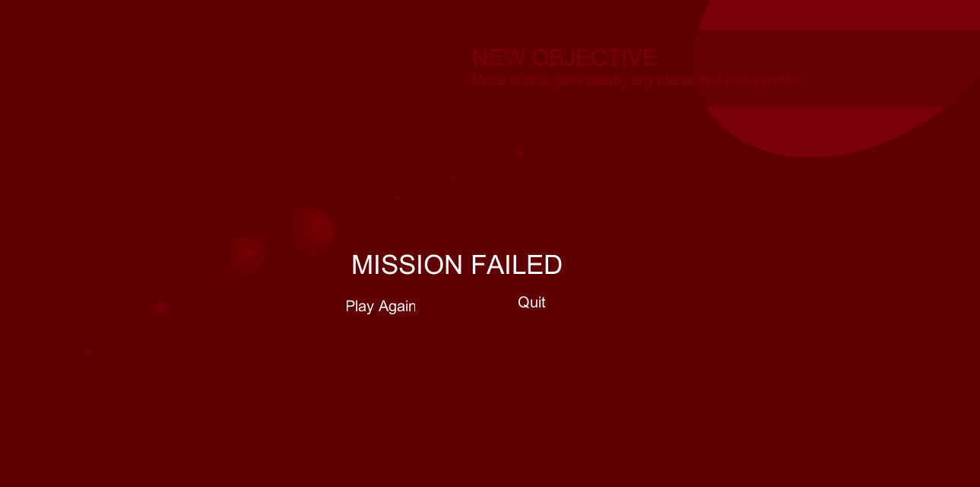
Screenshots
MISSION ACCOMPLISHED
MISSION FAILED

Slide 13
What did I learn ?
Unity
Github
Coding standards

Slide 14
Conclusion
Good learning method
Useful in education

Slide 15
Demo

